Slide 1
Local Action Group Kirkovo-Zlatograd

Slide 2
About LAG Community
Founded in 2010 as LAG Kirkovo 2010 Ass
In 2016 added Zlatograd
Association – NGO
Members 36; 4 public +16 business+16 NGO
Board – 5;
From 05/2018 implementation of Strategy for CLLD

Slide 3
About LAG Territory
2 Municipalities - Kirkovo and Zlatograd
Population - 341 t.
Business and Institutions
Communications and infrastructure

Slide 4
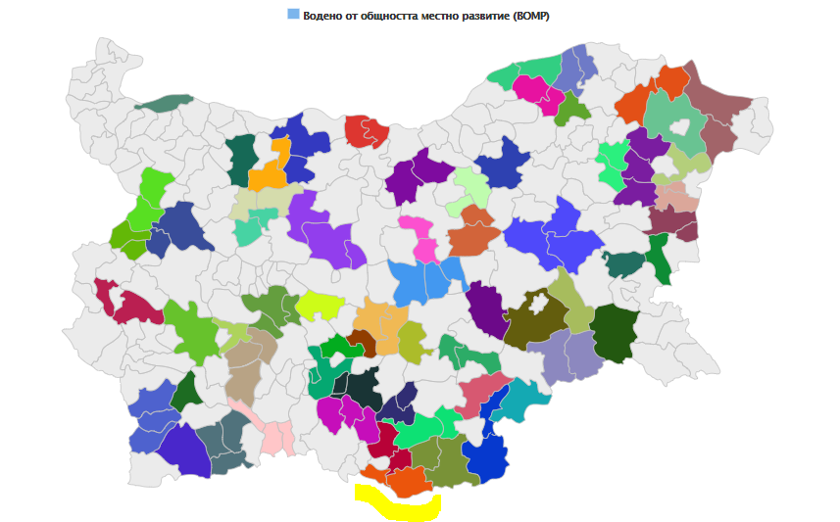

Slide 5
Facts
Southernmost Bulgarian city – Zlatograd /Zlato=Gold/
Southernmost point of Bulgaria - Veykata Peak;
Natural Stone phenomena.
MUMIO - The unique natural medicinal product
Ethnographic areal complex and architectural monuments;
The oldest church in the Middle Rhodope "Assumption" 1834
The Wooden Mosque (The Mosque of the Seven Girls)
The song "Deliyo Haidutin" - Voyager space message to civilization;
Feast - Zlatograd Cheverme, Pepper Festival,
Two Cross borders Chekpoints -Zlatograd/Xanthy and Makaza/Nimfea to Komotini

Slide 6
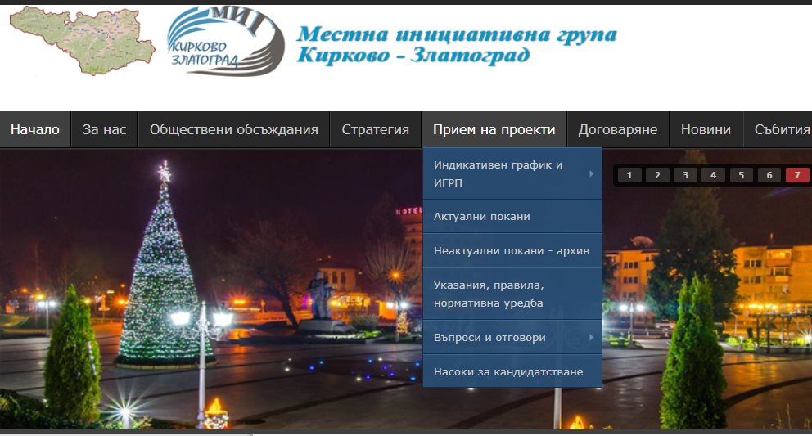
www.mig-kirkovo-zlatograd.com

Slide 7
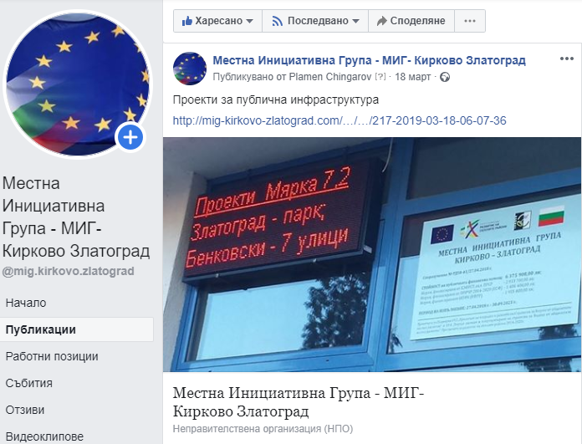
Information in FB

Slide 8
Information in our offices
Information
Materials
Advices
Consultation

Slide 9
MILESTONES - key periods
27.04.2018 – Agreement for Strategy CLLD implementation (2018-2023)
1
2018- 09.2020 – Project proposals
2
2019-2023- Project implementation
3

Slide 10
19.2-Strategy CLLD for LAG
FOUND | BUDGET, thous.bgn
ПРСР/ EAFRD | 2 738
EAFRD | 196
OP HRD/ ESF | 1 486
ОP IC/ ERDF | 1 956
Total | 6 376

Slide 11
WHERE TO APPLAY?
BUSINES
PUBLIC
AGRI
NGO
ИК2,2
7,2
4,1
7,5
6,4
7,5
4,2
ЧР2
ЧР1/2
ЧР1/2
6,4

Slide 12
PROJECT PROPOSALS
Procedure | submitted projects, num | number of approved projects | number of contracts
4,1 | 7 | 6
4,2 | 4 | 4
6,4 | 33 | 11
7,2 | 2 | 2 | 2
7,5,1 | 13 | 9 | 7
HR-1 | 5 | 4 | 4
HR-2 | 2 | 2 | 2
IC-2,2 | 7 | 7 | 7
ALL for LAG | 66 | 45 | 22

Slide 13
Projects, BGN*1000

Slide 14
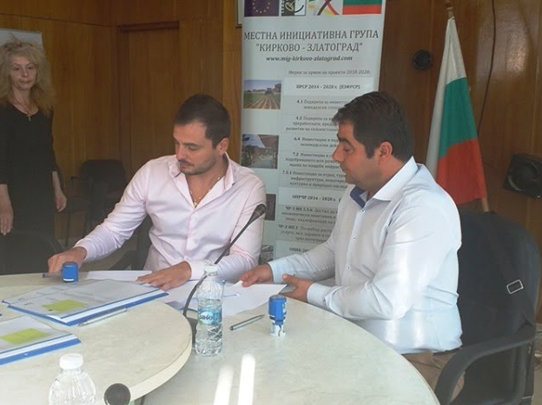
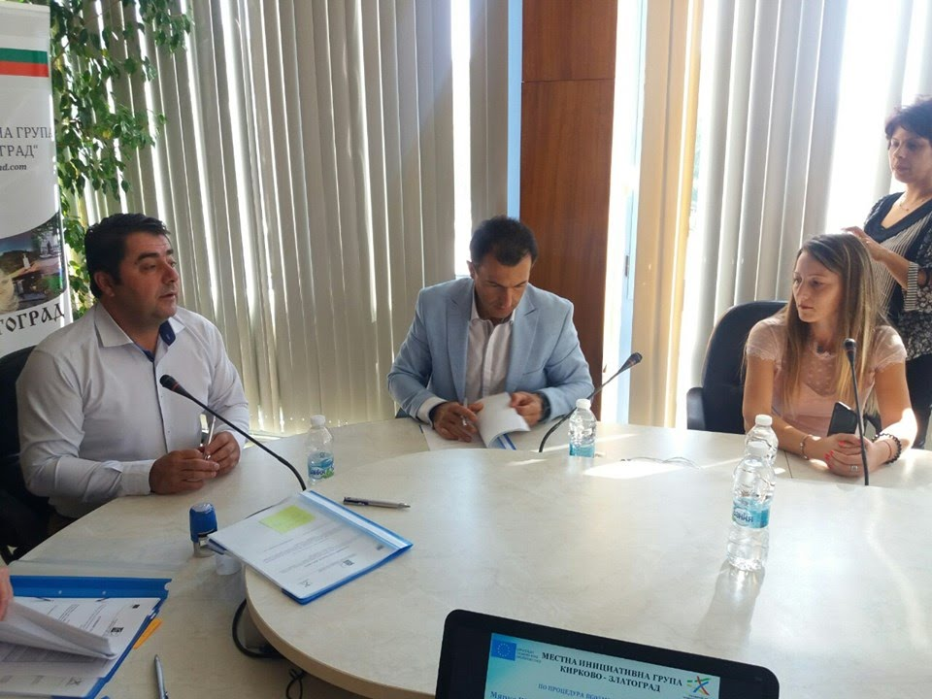
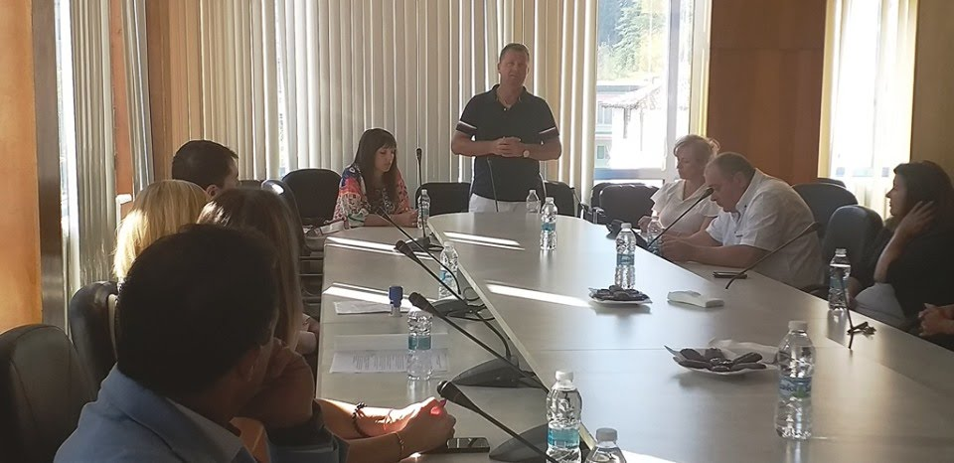
PROJECT CONTRACTS-OP HRD 1

Slide 15
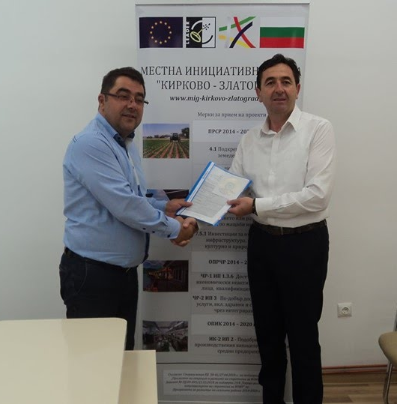
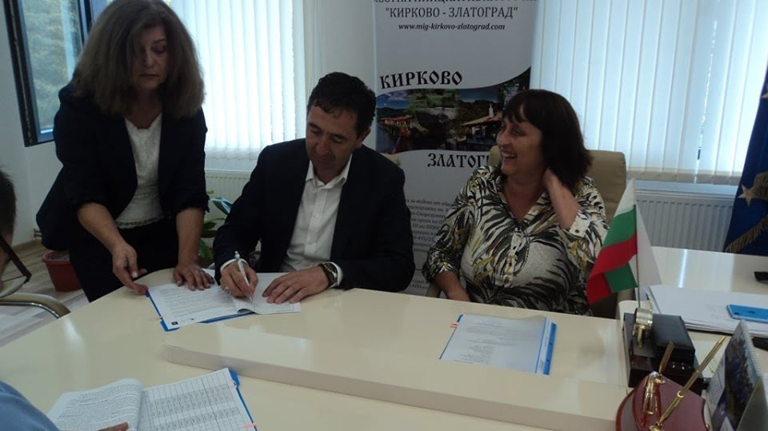
PROJECT CONTRACTS-7,2

Slide 16
Project Implementation Mashinery ERDF robotic welding system

Slide 17
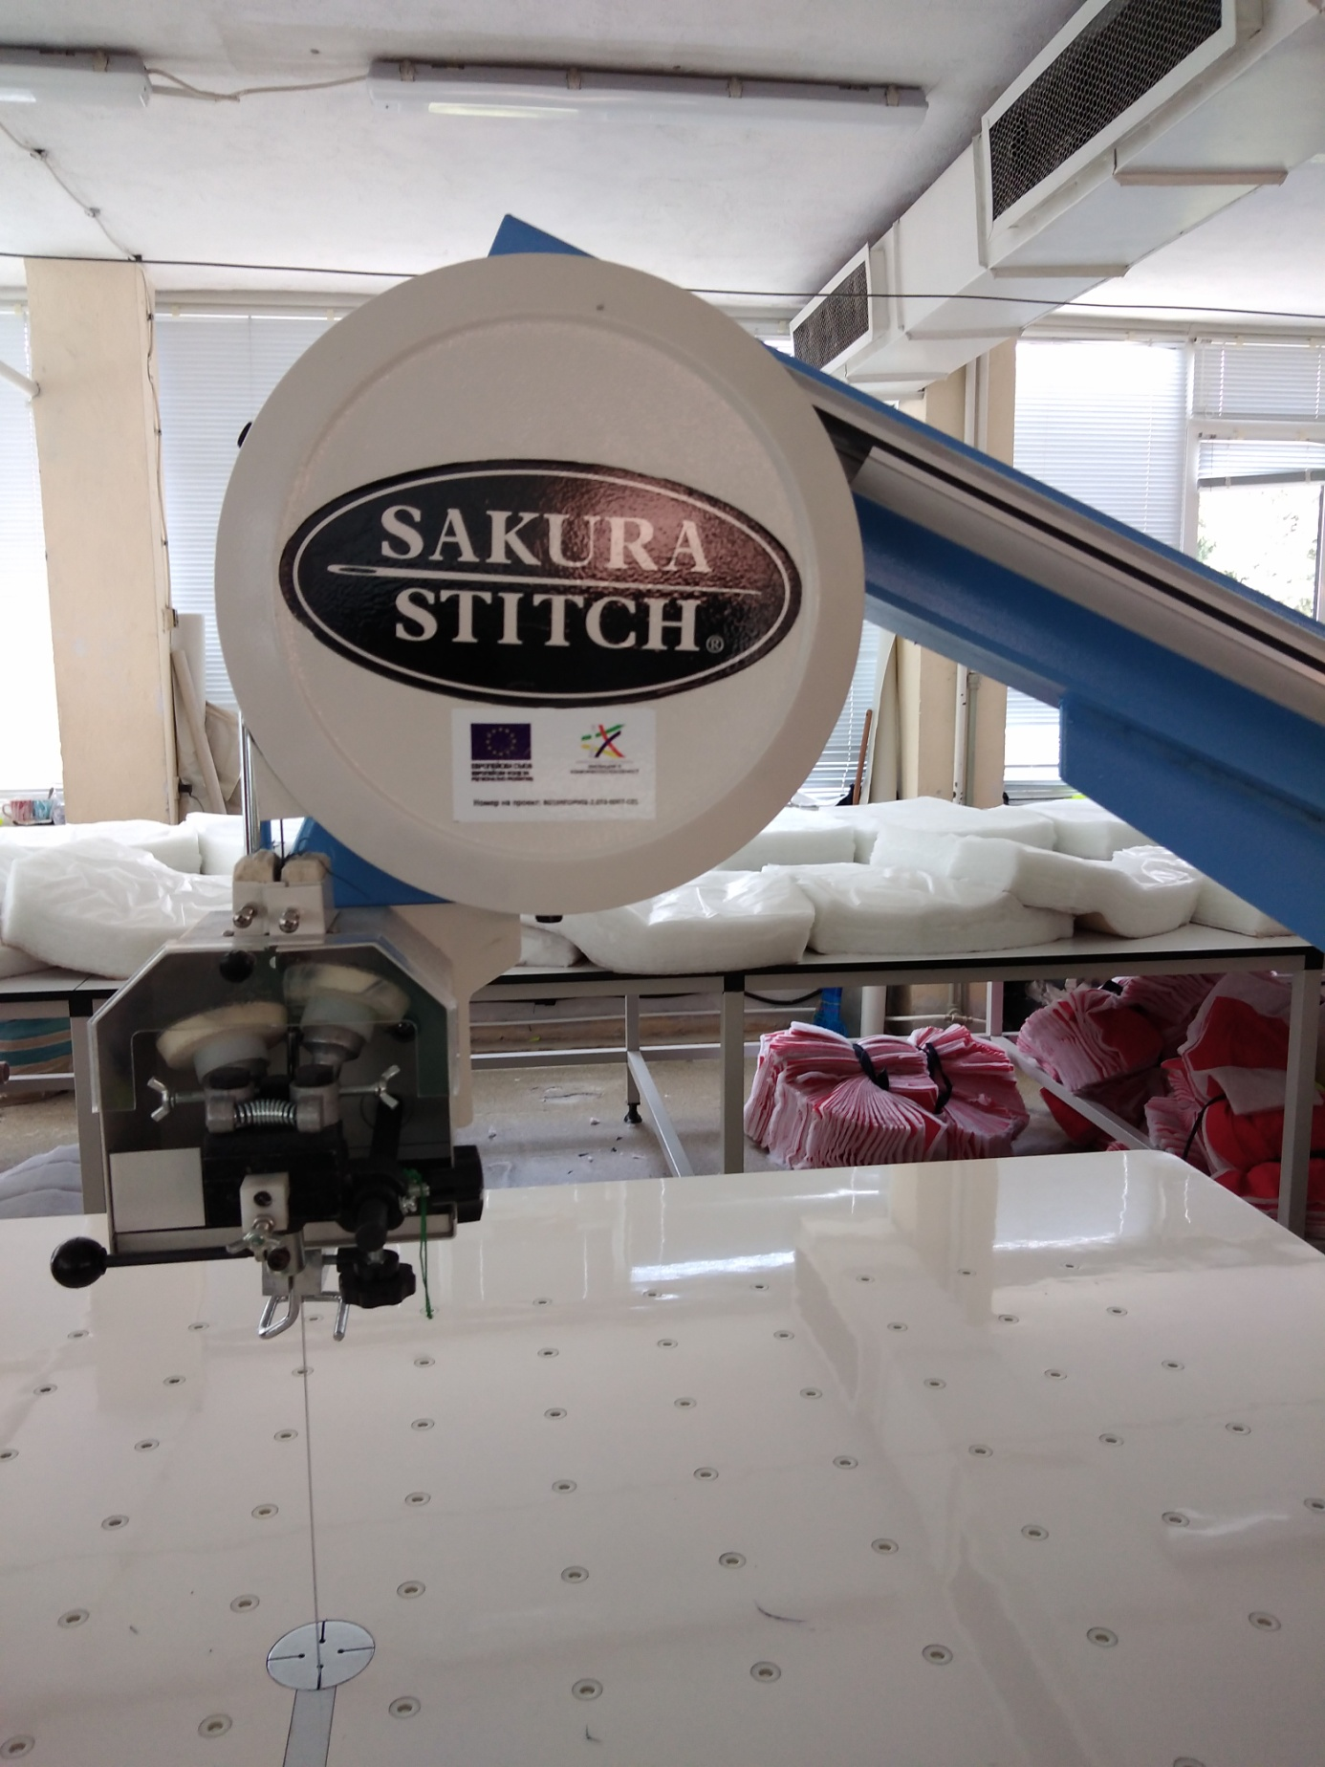
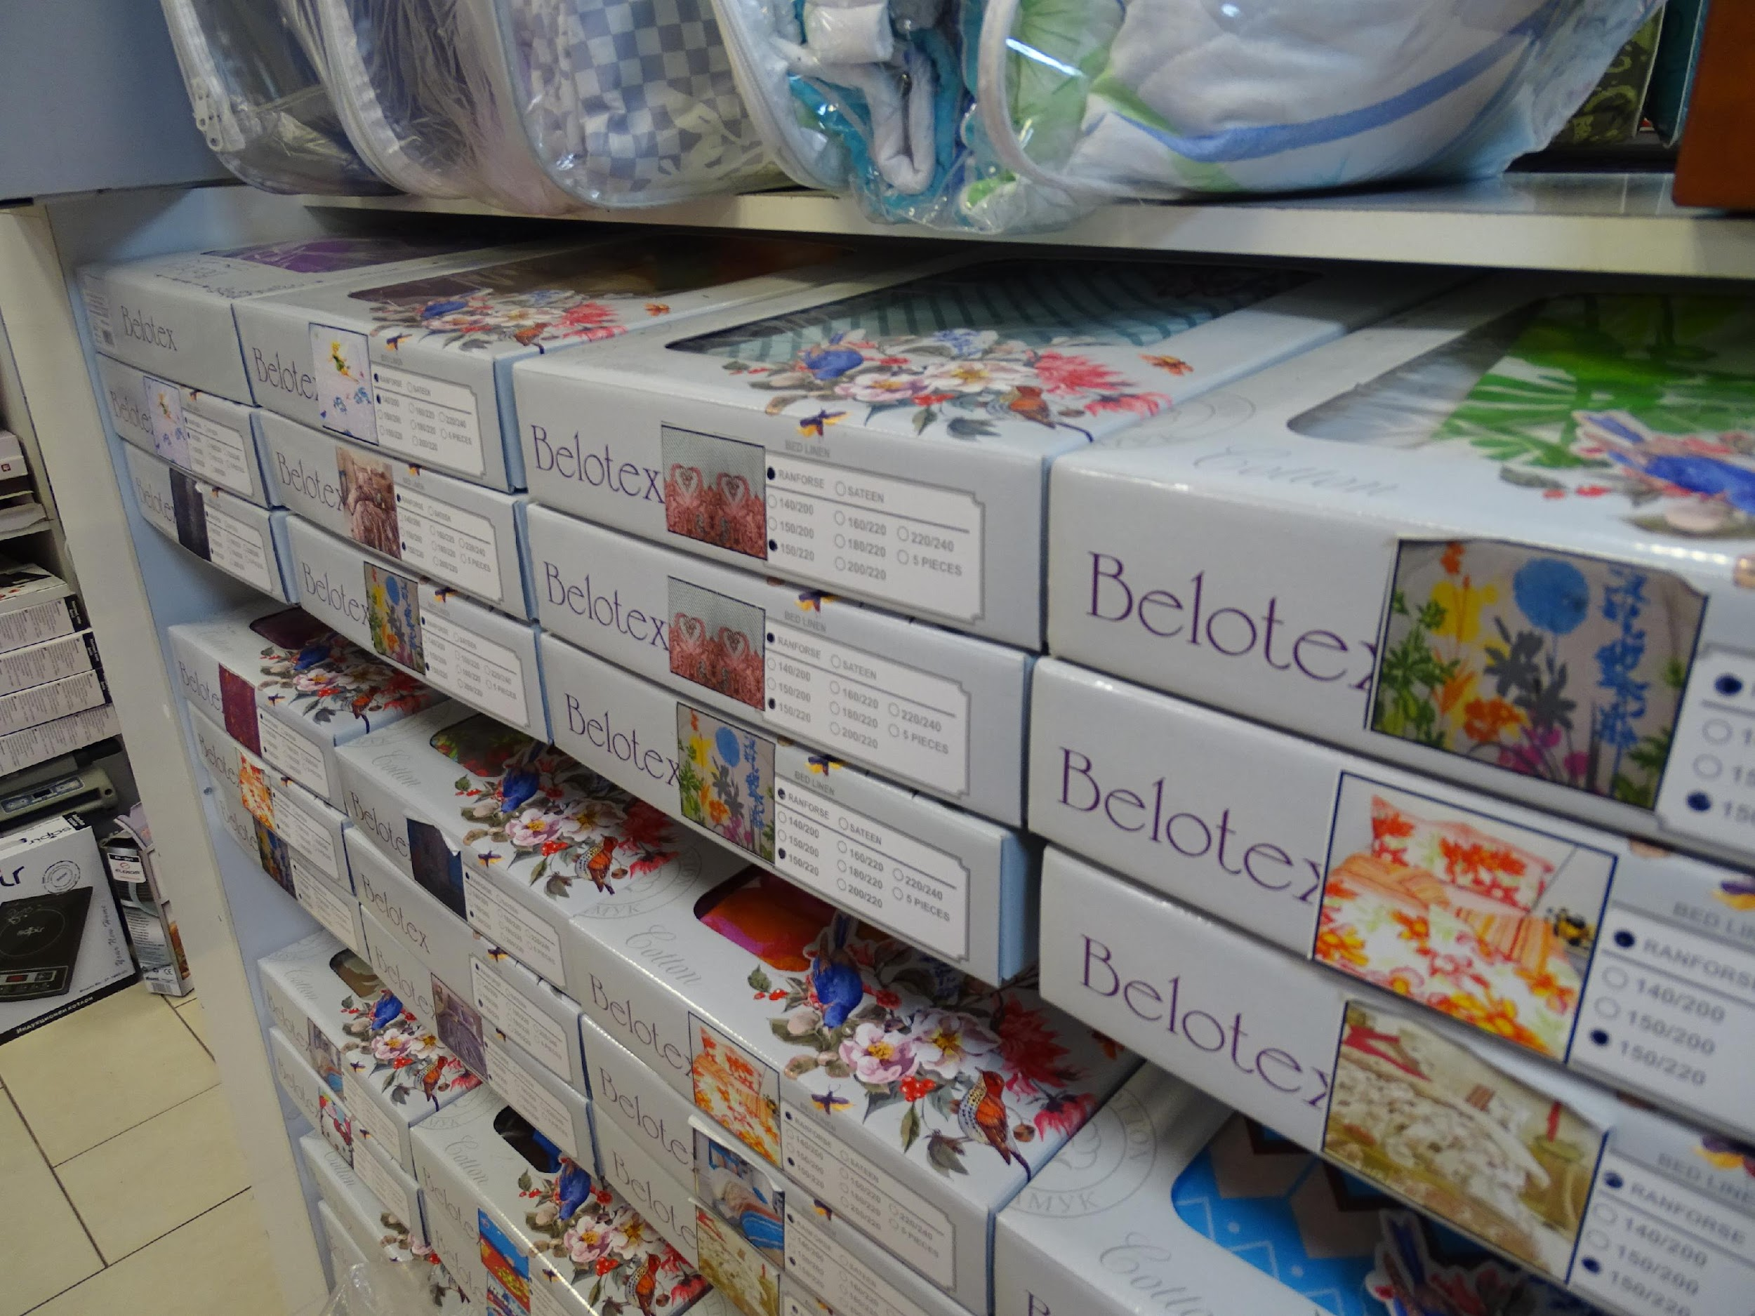
Sector-Communications – OPIC - infrastructure with optical network to television and internet
Light industry

Slide 18
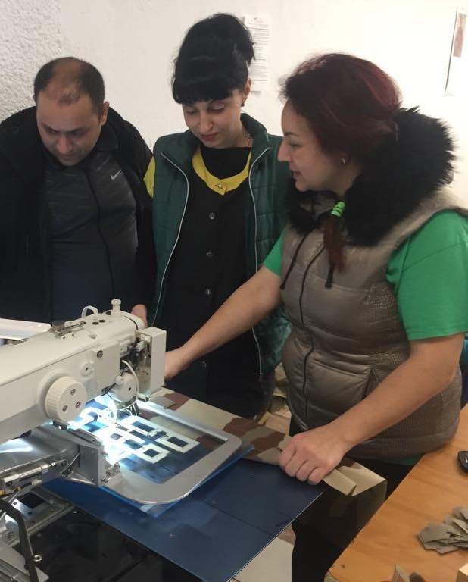
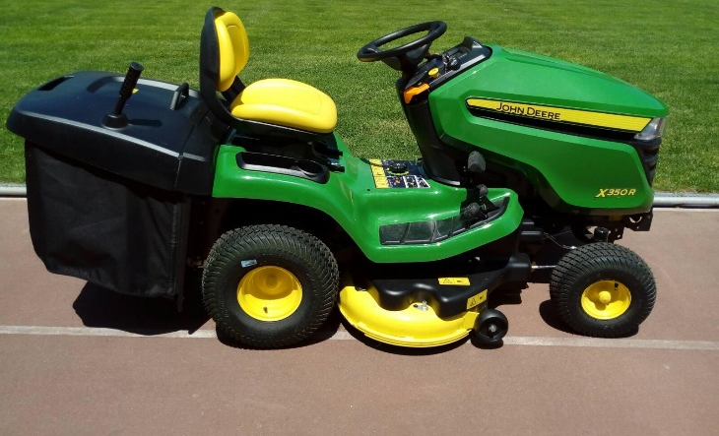
Light industry HRD / ESF training, employment, equipment ОП РЧР

Slide 19
LAG Kirkovo-Zlatograd
00359 4205
www.mig-kirkovo-zlatograd.com
Agreement 50-41/ 27.04.2018 -19,4 от ПРСР 2014-2020.

