Slide 1
Support of Entrepreneurship in the Field of In-House Processing of Quality Farm Products in the Districts of Evros, Haskovo, Smolyan and Kardzhali QUALFARM
Closing Conference Of QUALFARM project, Zlatograd- Culture House .
Petresis Georgios, Msc , Director & Project Manager of ‘’Qualfarm’’

Slide 2
Introduction of the QUALFARM project
Enhance the skills of farmers and existing farm products’ in-house processing firms in the fields of quality, innovation and marketing
Stimulate further entrepreneurship in the field of farm products’ in-house processing through mentoring and personalised support
Create and promote a distinct cross-border farm products’ market
Create permanent support structures for the agri-food sector and particularly the farm products’ in-house processing sector
Raise awareness of the general population on issues of food quality and safety

Slide 3
QUALFARM Goals
Establishment of permanent business support structures within the partners’ organisations, dedicated to the entrepreneurship in the field of in-house production and engagement of young adults and women
Promotion of entrepreneurship in qualitative in-house production and trading in compliance with the legislation in force
Awareness and mobilisation of labour resources for small size entrepreneurship in the field of in-house production
Promotion of the importance of qualitative packaging of quality products, produced in-house
Exchange of experience between the producers and stakeholders of the two sides of the border
Improvement of the entrepreneurship in the field of in-house production for both sides of the border
Prevention of the depopulation of the area of intervention.

Slide 4
QUALFARM Project Partners
LB (PB1) Rural Research and Development Company of North Evros S.A. (GR)
PB2 Dimosineteristiki Evros S.A. (GR)
PB3 Reconstruction and Development Union (BG)
PB4 Non-profit Association “Local Action Group of Kirkovo-Zlatograd” (BG)

Slide 5
QUALFARM Project activities and accomplishments
KEY ACTIVITIES
Publishing the QUALFARM Cross-Border Guide of In-House-Processed Farm Products
Mentoring Local Farmers for Initiating In-House Processing of Farm Products
Exchanging Good Practices Within the Cross-Border Area Through Targeted Study Visits

Slide 6
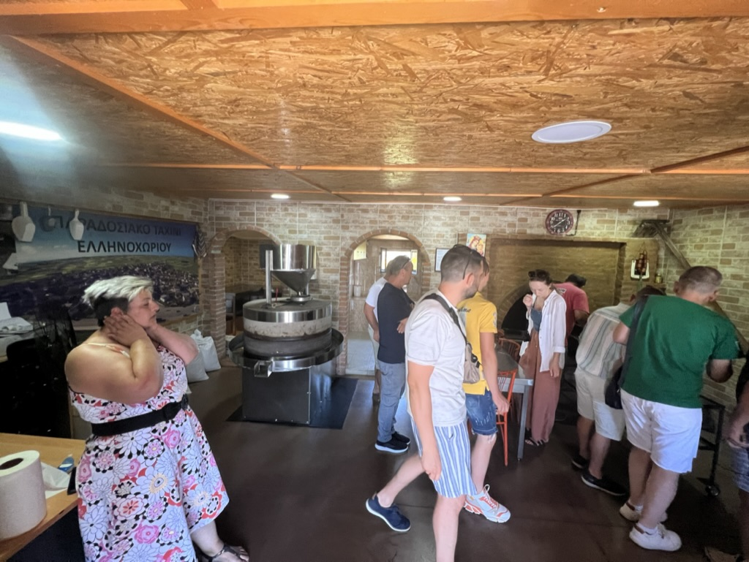

Slide 7
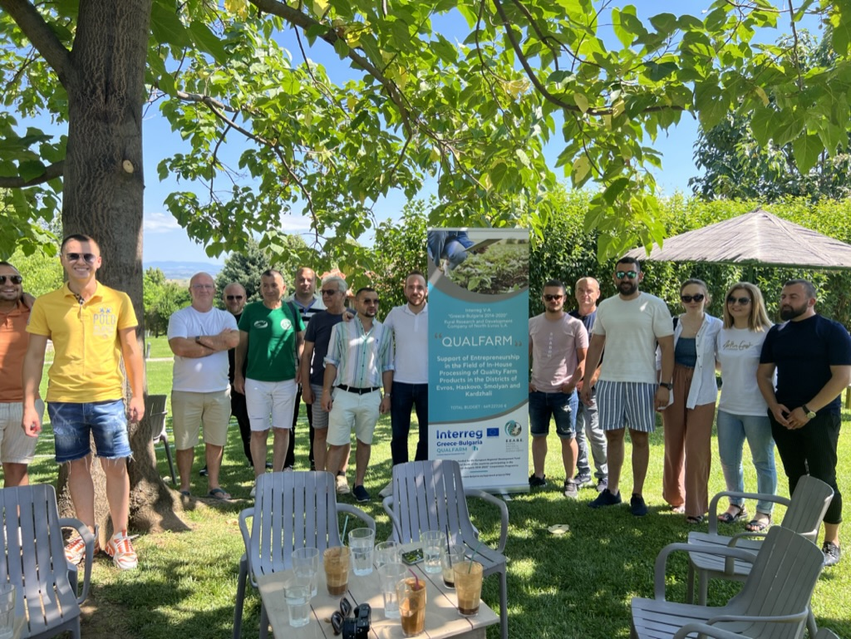
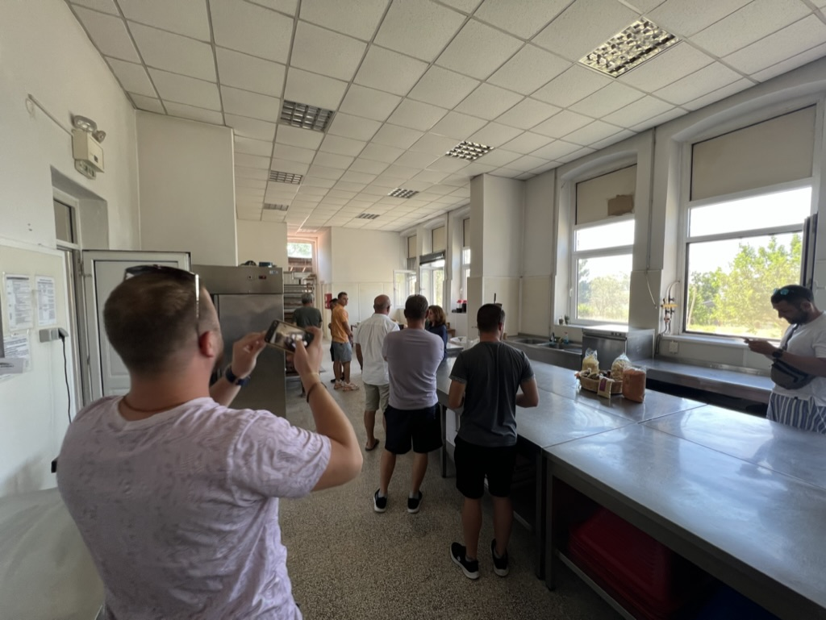

Slide 8
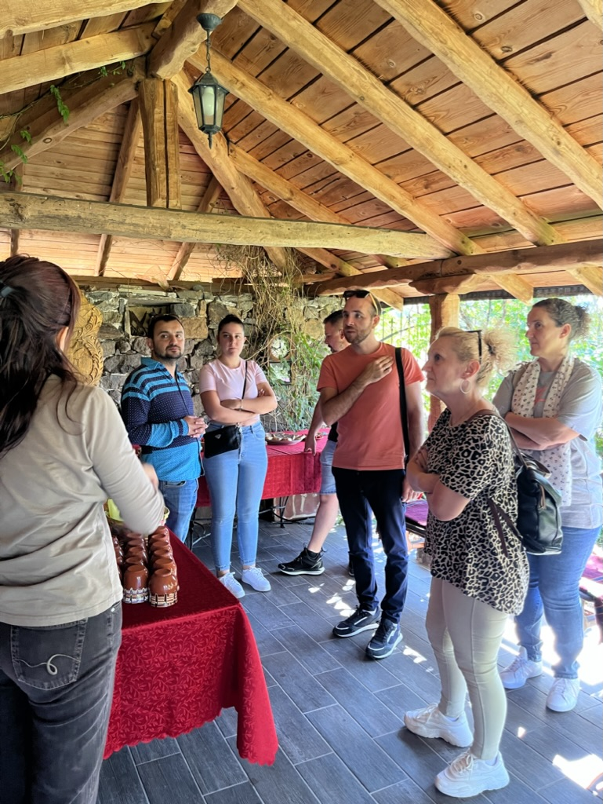
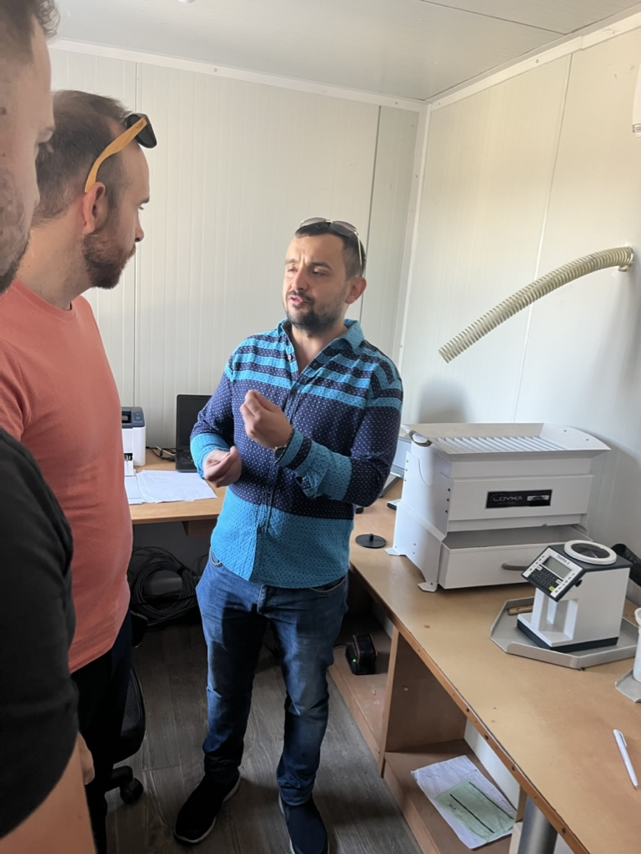

Slide 9
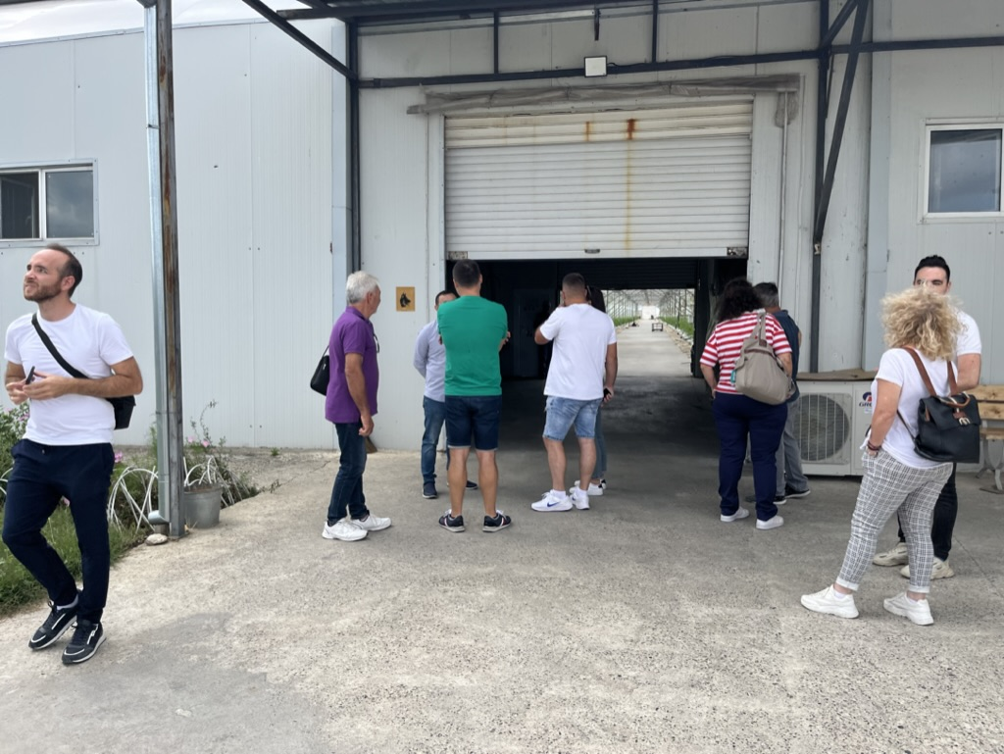

Slide 10
QUALFARM Project activities and accomplishments
KEY ACTIVITIES
Publishing the QUALFARM Cross-Border Guide of In-House-Processed Farm Products
Mentoring Local Farmers for Initiating In-House Processing of Farm Products
Exchanging Good Practices Within the Cross-Border Area Through Targeted Study Visits
Creating a Beginner's Guide for In-House Processing of Farm Products

Slide 11
QUALFARM Project activities and accomplishments

Slide 12
QUALFARM Project activities and accomplishments
KEY ACTIVITIES
Publishing the QUALFARM Cross-Border Guide of In-House-Processed Farm Products
Mentoring Local Farmers for Initiating In-House Processing of Farm Products
Exchanging Good Practices Within the Cross-Border Area Through Targeted Study Visits
Creating a Beginner's Guide for In-House Processing of Farm Products
Creating a Practical Promotion and Marketing Guide for In-House-Processed Farm Products

Slide 13
QUALFARM Project activities and accomplishments

Slide 14
QUALFARM Project activities and accomplishments
KEY ACTIVITIES
Publishing the QUALFARM Cross-Border Guide of In-House-Processed Farm Products
Mentoring Local Farmers for Initiating In-House Processing of Farm Products
Exchanging Good Practices Within the Cross-Border Area Through Targeted Study Visits
Creating a Beginner's Guide for In-House Processing of Farm Products
Creating a Practical Promotion and Marketing Guide for In-House-Processed Farm Products
Studying the Cross-Border Area's Background and Perspectives for In-House Farm Products' Processing

Slide 15
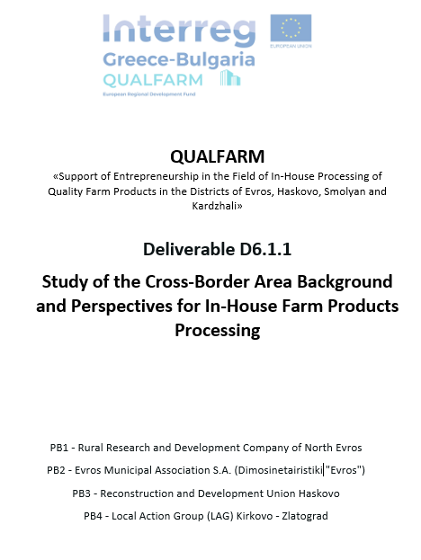
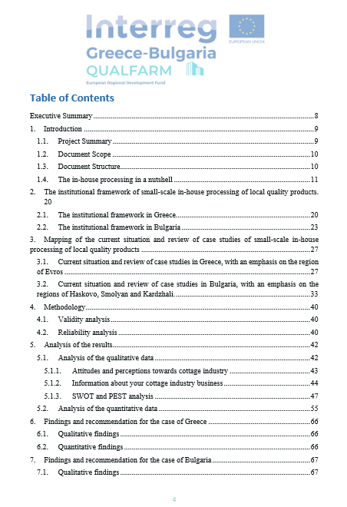
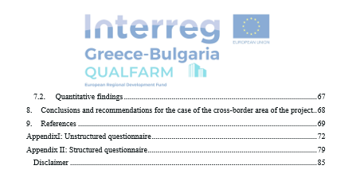
QUALFARM Project activities and accomplishments
Studying the Cross-Border Area's Background and Perspectives for In-House Farm Products' Processing

Slide 16
Impact of the project QUALFARM
Support of rural SMEs through grants.
QUALFARM Business Support Structures that will operate within the agencies may - at the same time - provide information for immediate access to funding and trigger entrepreneurship in the countryside.

Slide 17
Impact of the project QUALFARM
CLLD LEADER 2014-2020 PROJECTS that boost the local Economy and can be used in the Future as FUNDS

Slide 18
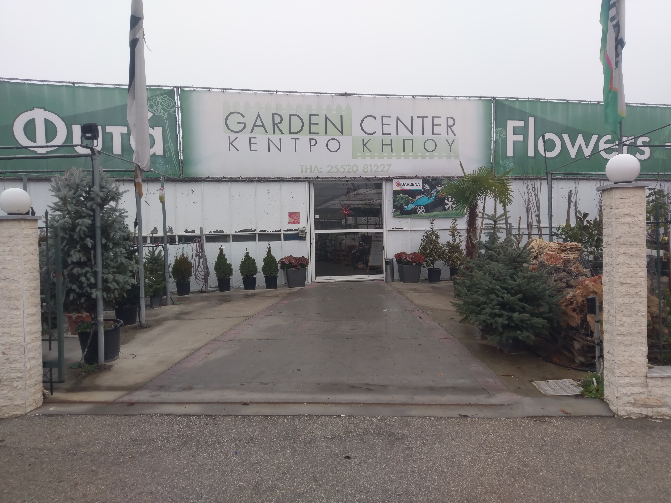
Private Sector
Garden Center Dolaptsis

Slide 19
Private Sector
Tahini Production ‘’Krios’’

Slide 20
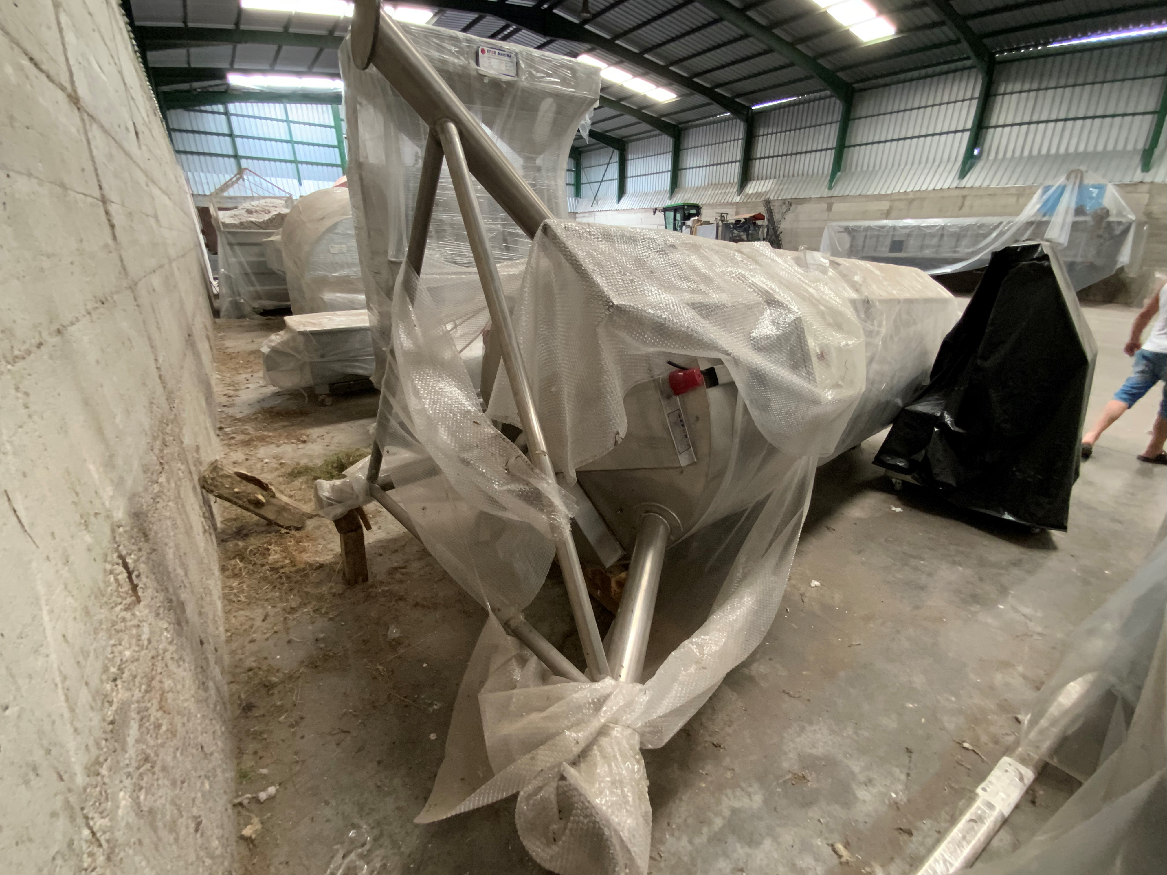
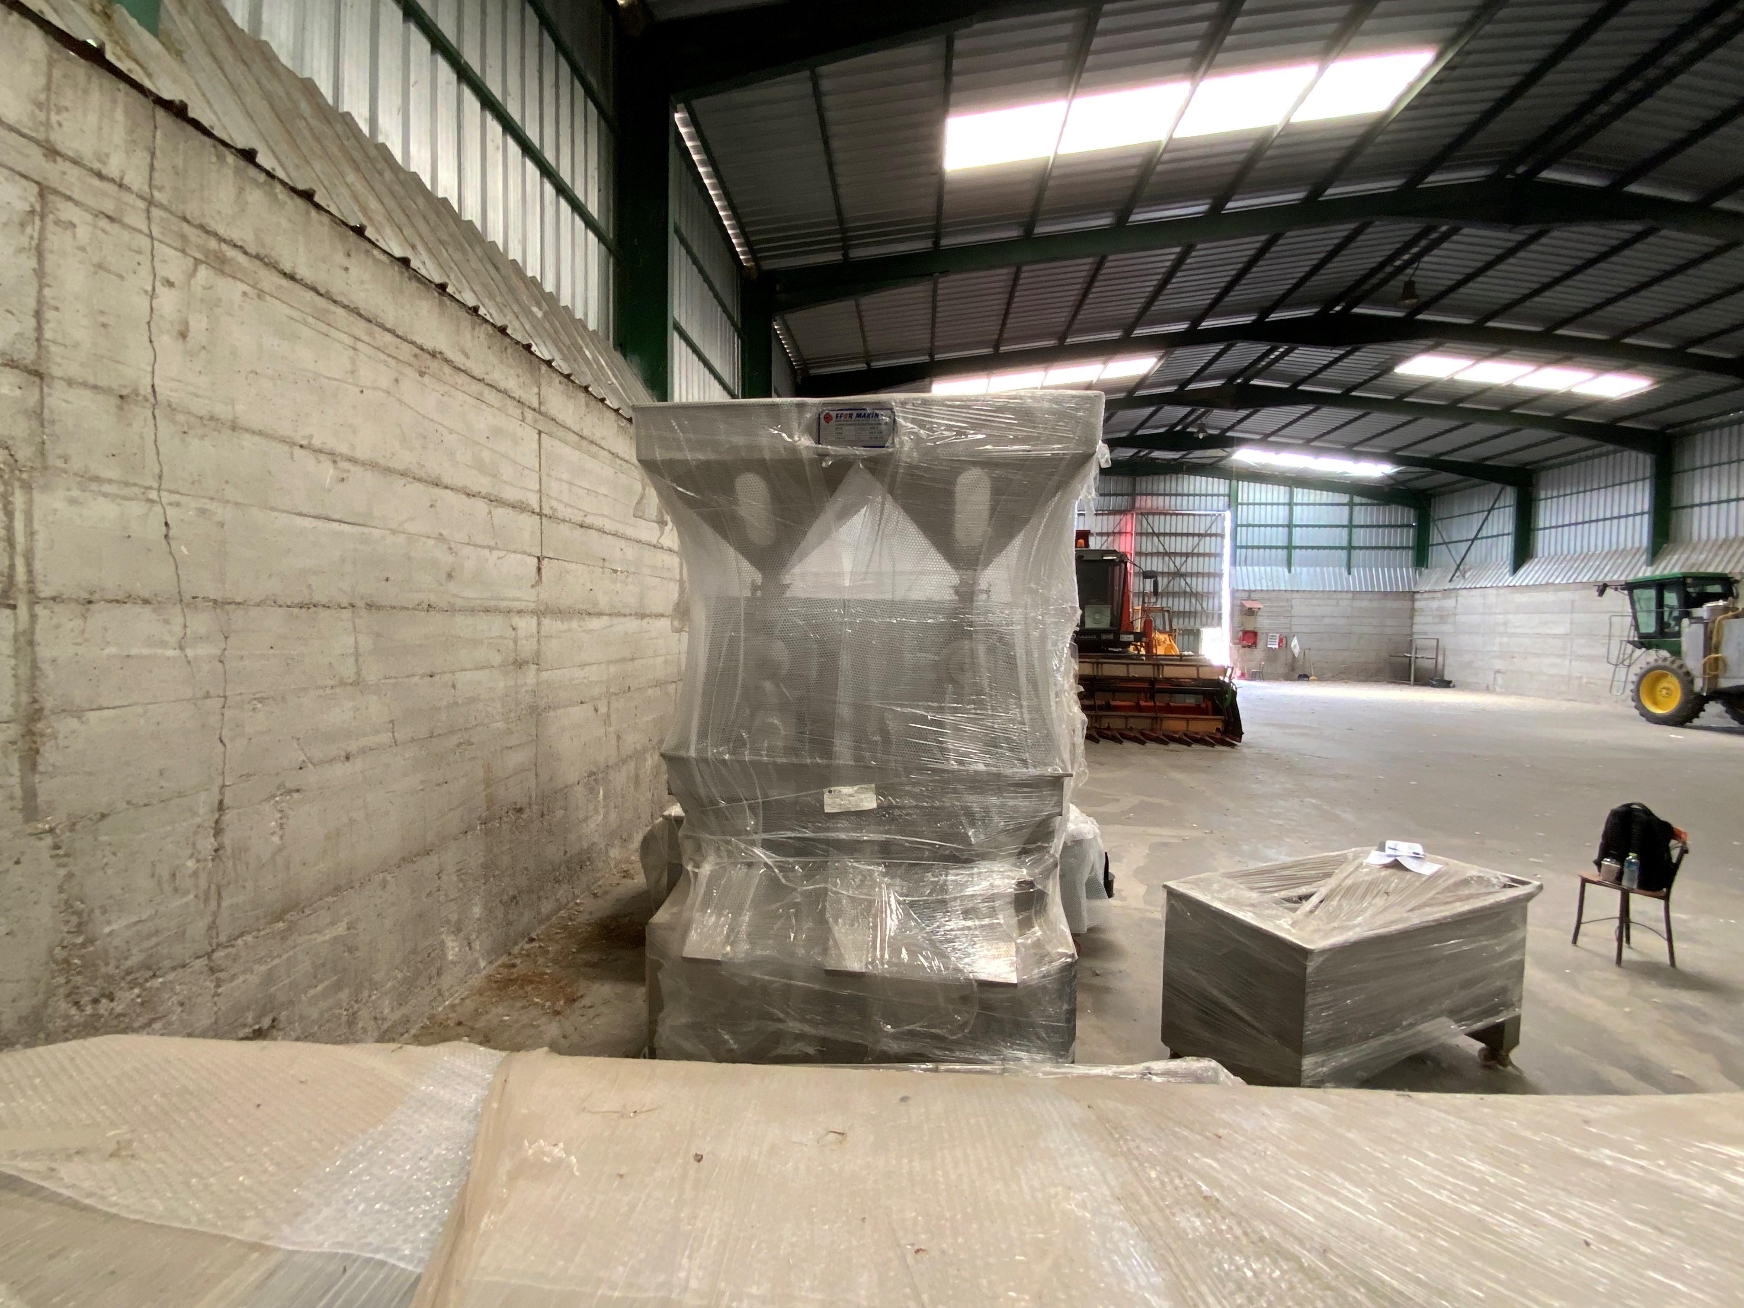

Slide 22
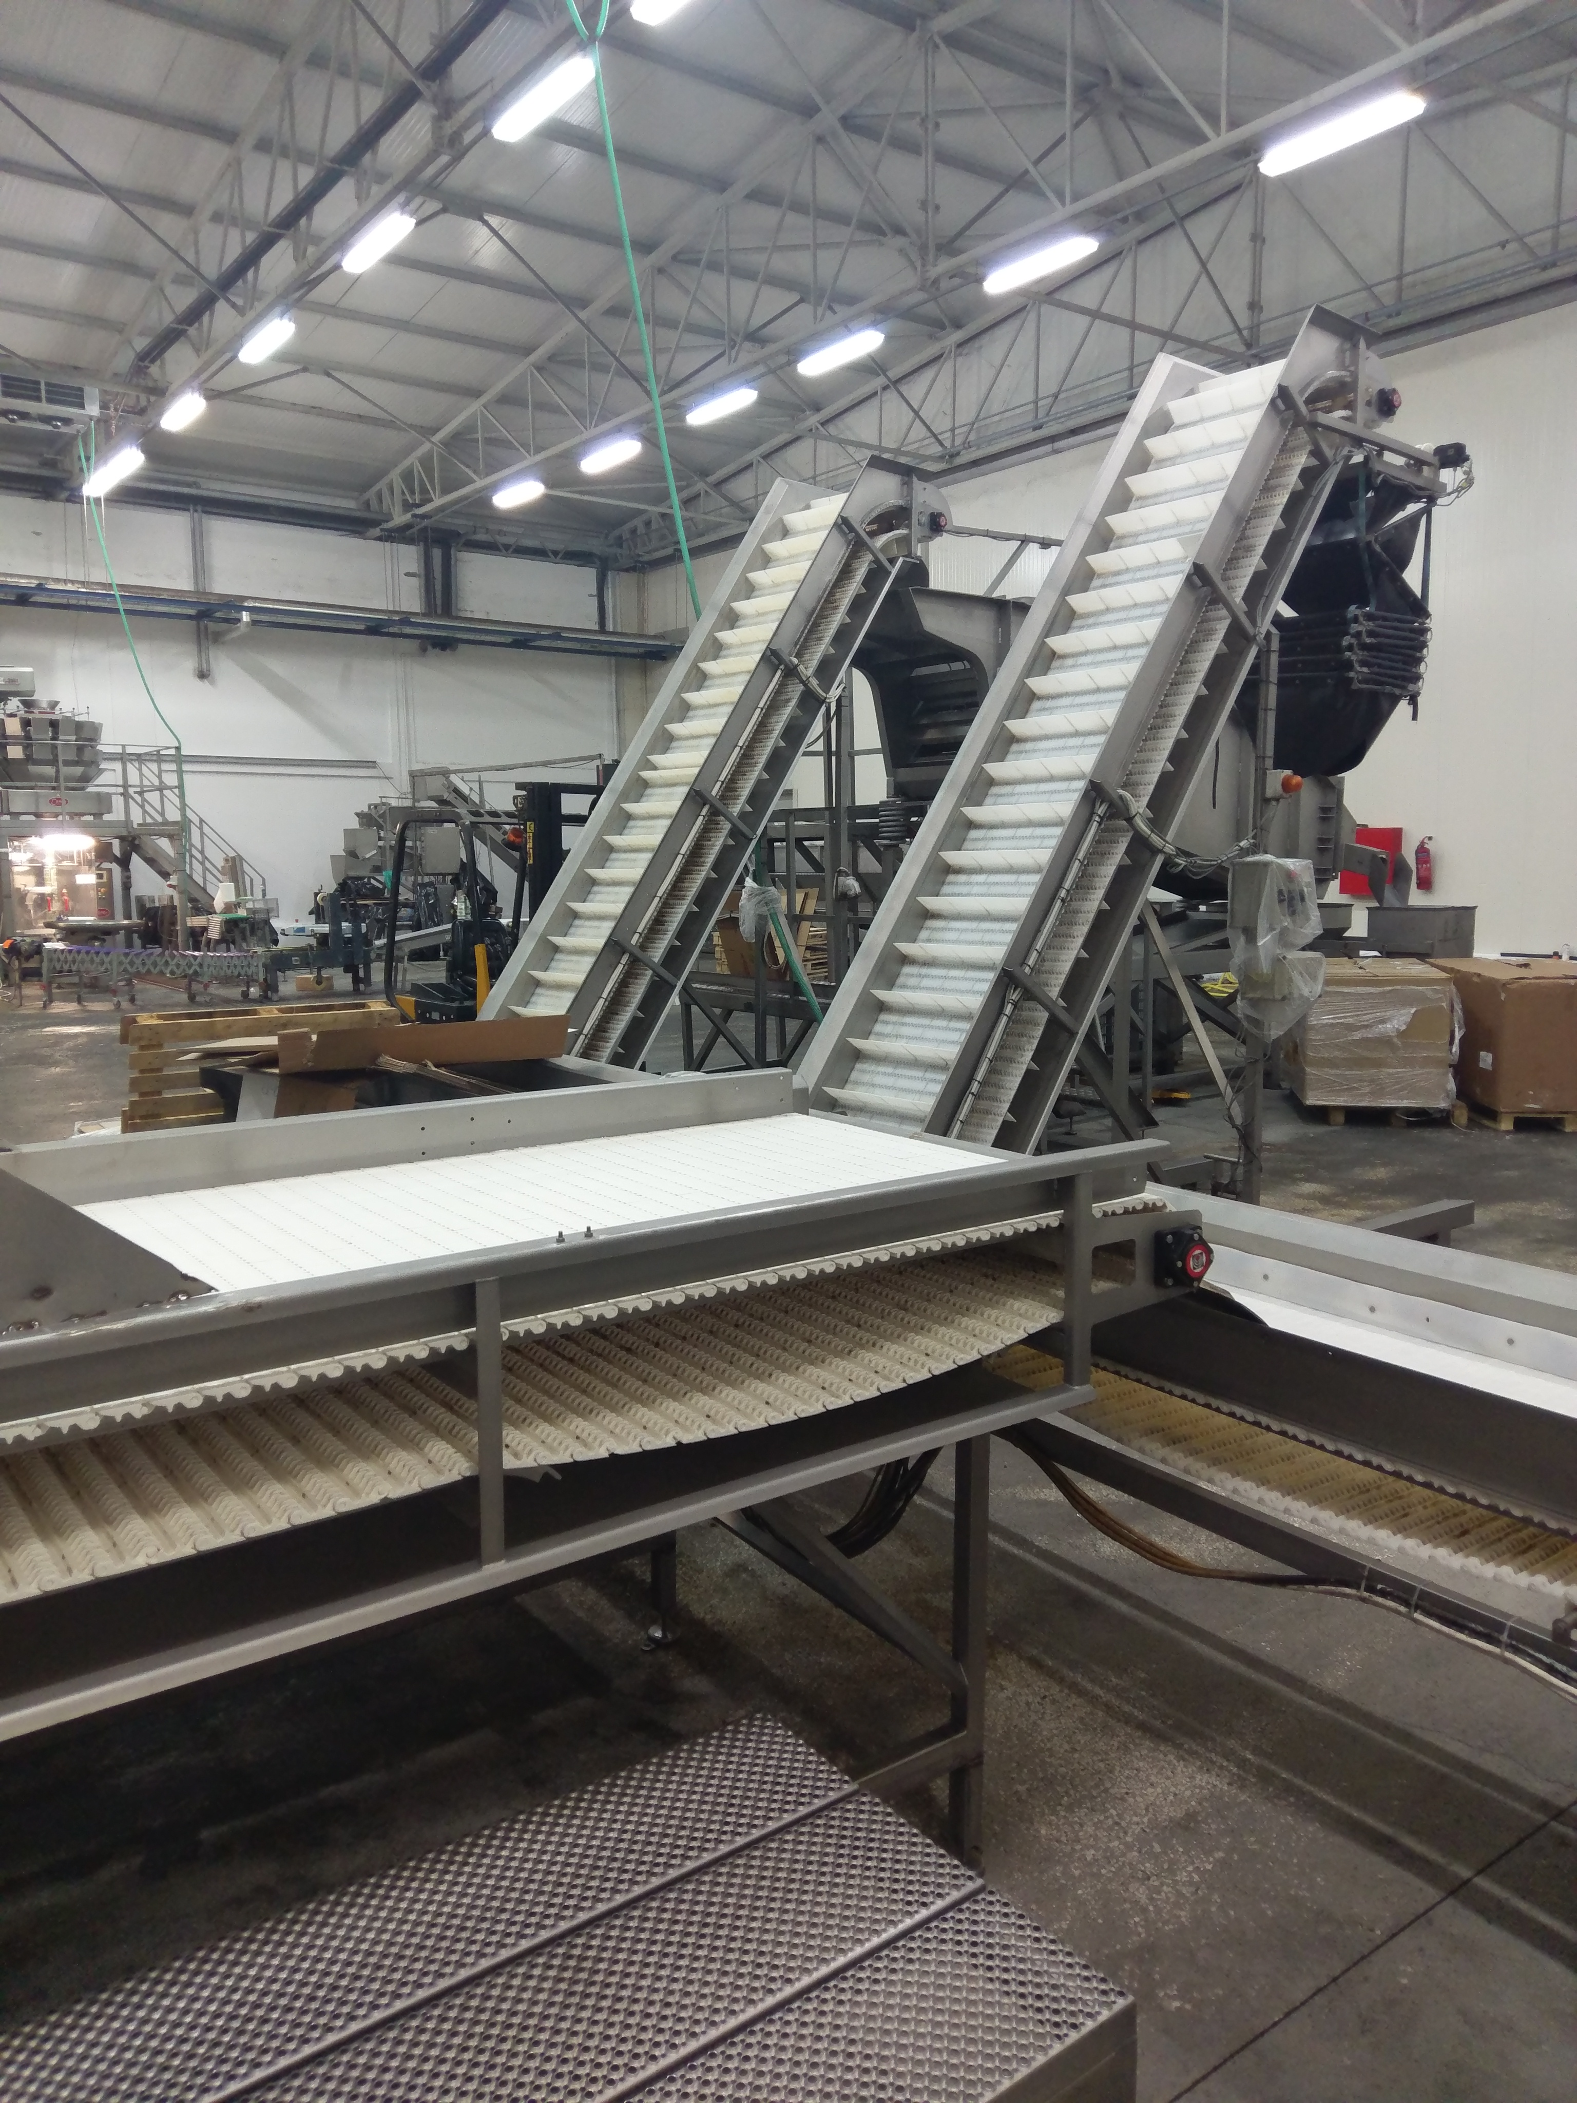
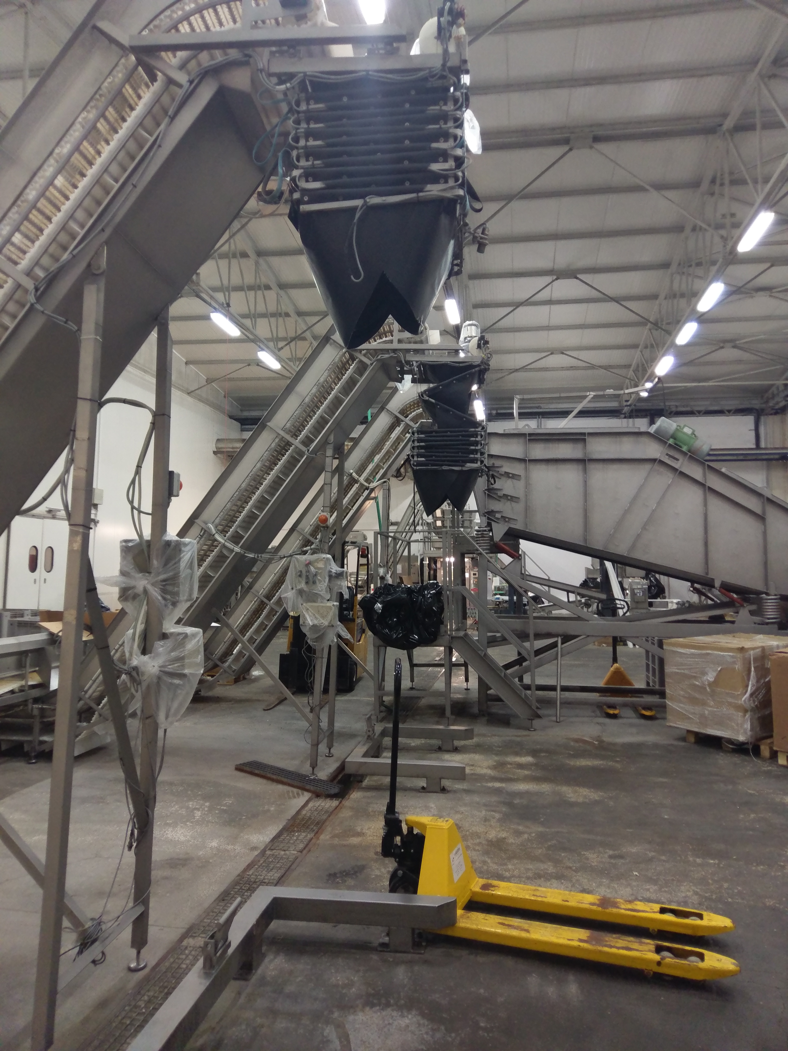
Ardas Frost

Slide 23
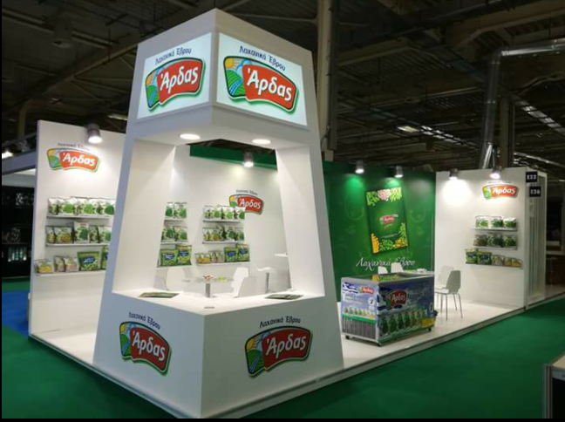

Slide 24
Peas
Green Beans
Okra
Seasonal Vegetables

Slide 25
Conclusion
Different operational practices were seen and knowledge was exchange
Inhouse farmers due to study visits exchanged contact info for future cooperation
Useful practical Quide’s were delivered and can be given for free to potential candidate but also to running companies
Cross border will enhance the dynamic of the inhouse farmers production in both countries

Slide 26
We look forward to a pleasant cooperation
Thank You!

Slide 27
Rural Research and Development Company of North Evros S.A./ΕΕΑΒΕ,
Address: Sotiriou Tserkezi 20,68200
Orestiada.
Tel: +302552027900
Fax: +302552027757
e-mail: eeabe@otenet.gr
eeabe18@gmail.com
qualfarm2021@gmail.com
web: www.eeabe.gr

